Slide 1


Name: Maryam Mujahid Class: 2nd year Department: Geography Subject: Human Geography Topic: Weber's Theory Assignment Submitted To: Ma'am Hameeda Ghani

Slide 2
Weber’ Industrial Theory
Maryam Mujahid
BSc(hons.)2nd year ☺

Slide 3
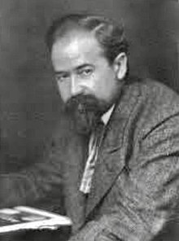
INTRODUCTION
Alfred Weber was a German economist, geographer, sociologist and theoretician of culture whose work was influential in the development of modern economic geography.
Published his Theory on Location of Industries in1909.
Earlier to Weber, another German economist Launhardt has given a simple principle of industrial location based on minimum transport cost. (30July 1868 – 2 May 1958)

Slide 4

Assumptions
Unit of study is taken as single country with consumption centre.
Some natural resources are ubiquitous.
E.g.: Water, Sand, Clay etc.
Some natural resources are localized in nature.
E.g.: Iron ore, Fuel etc.
Labour is not ubiquitous but it has fixed location and fixed mobility.
Homogeneous climate

Slide 5
Explanation:
Factors Influencing Industrial Location
Regional Factors or Primary Causes
Transport Cost
Labor Cost
Intra Regional Factors or Secondary Causes
Agglomerative
Deglomerative

Slide 6
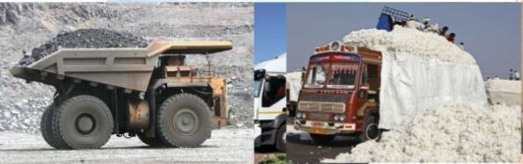
TRANSPORT COST
Transport cost are influenced by three basic elements.
The weight to be transported.
The distance to be covered.
The nature of commodity.
E.g. 1000 kg of Gold Ore will give you only10 kg of pure Gold

Slide 7
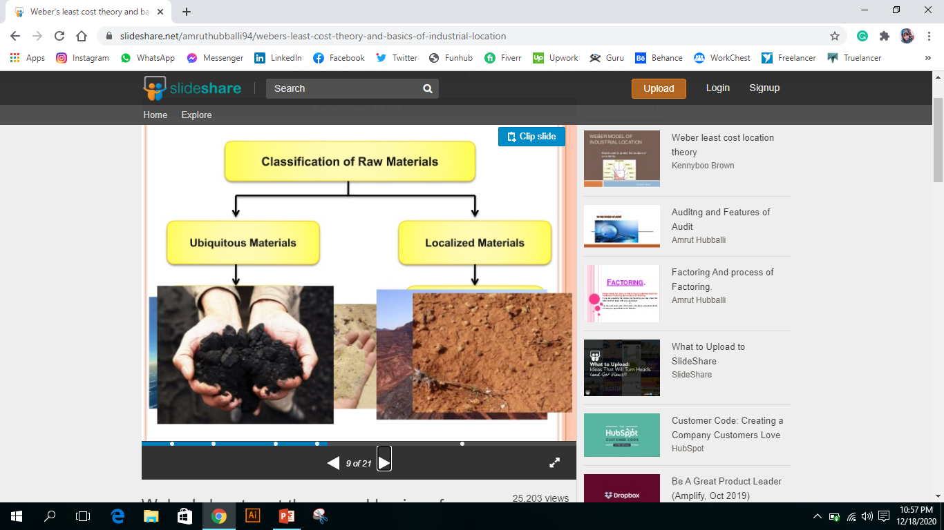
Classification Of Raw Material
Ubiquitous material
Localized Material

Slide 8
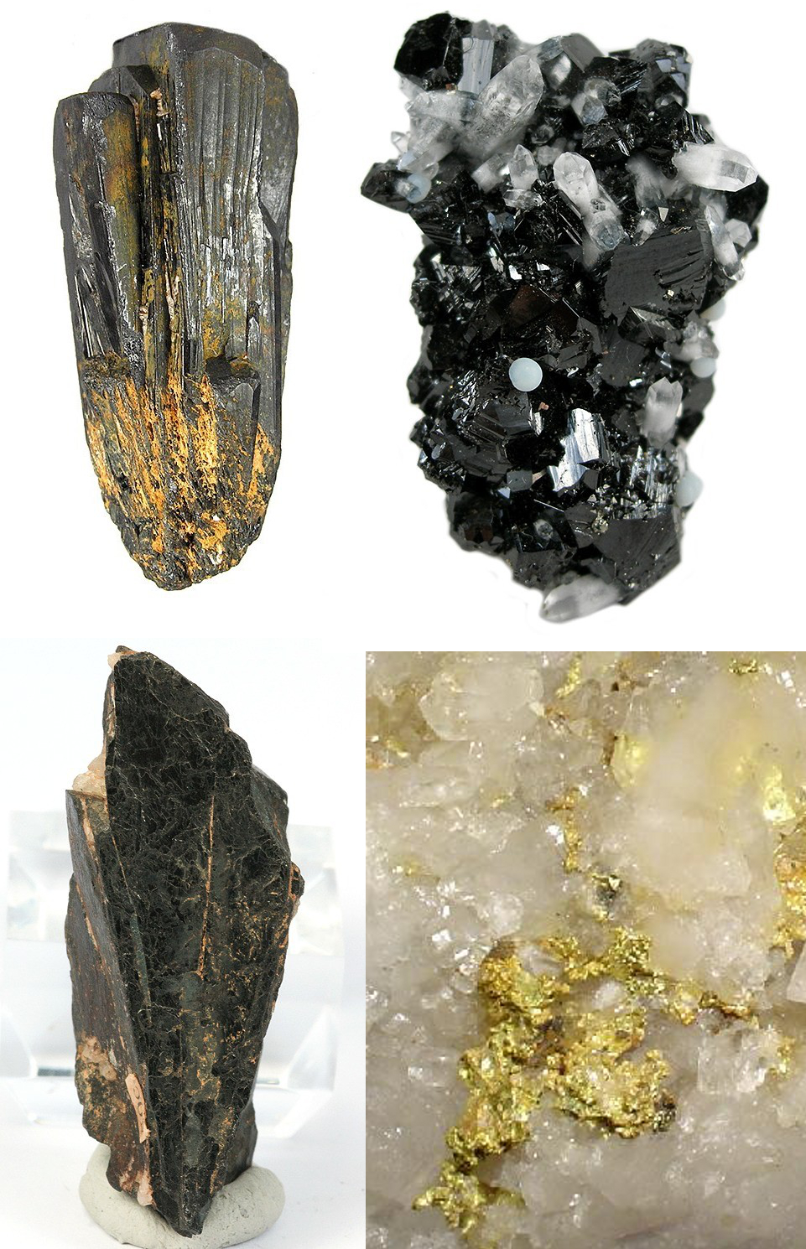
MATERIAL INDEX
Material index On the basis of the above reasoning Weber developed a mathematical formula to measure the relative pull of materials while those with low materials and the market on industrial location
Material index=weight of localized material/weight of the finished goods.
If material index > 1 then plant will be located near the resources .
If material index < 1 then plant will be located near to the market.

Slide 9


ROLE OF LABOUR COST
It is describe with the help of given mathematical analysis. These are:Index of labour cost: It is the average cost of labour needed to produced one unit weight of output.Labour Co-efficient: It is the ration between cost per unit of product to the total weight of raw material and product to be moved.Critical Isodapane: Weberterms the isodapane which hasthe same value as the saving inlabour cost the critical isodapane.

Slide 10
Agglomerative
Agglomerative factors are the external economies which result from concentration of industries at a particular place
Deglomerative
These are external diseconomies that causes geographical dispersal of industry

Slide 11

CRITICISMS
Transport cost s do not rise proportionally with distance and weight Perfect competition of market rarely exists.Weber ignored the spaced problem, high cost of land and high rent in the industrial area.Historical factors do not have been considered in the location of industry.Impact of price fluctuation does not consider.Break of bulk point do not has been considered.Homogeneous areas have been questioned

Slide 12
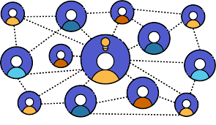
CONCLUSION
The theory is important because of its pioneering nature and its effects on later researchers .The real test of theory is that it should accord with reality, and empirical studies as Isard’s work on US Steel Industry and Smith’s works on weight- losing in Britain have, however, shown the validity of many weber’s conclusion

Slide 13


